Slide 1
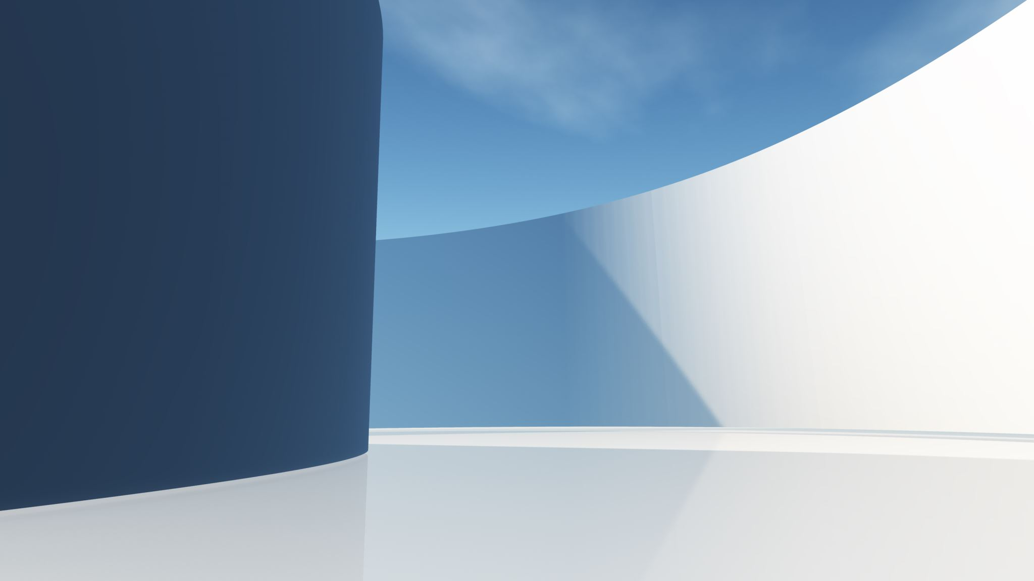
Developing a desktop application to optimise neural networks
By John Ray
Supervisor: Prof. Edward McCann

Slide 2
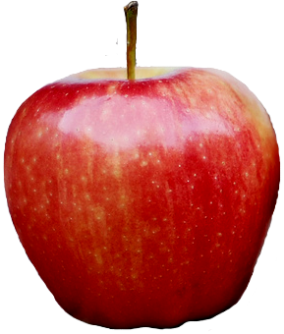
What is a Neural Network?
A machine-learning model inspired by the human brain.
They use interconnected nodes (akin to neurons) to detect patterns in data that conventional algorithms would not find.
Size
Input data:
Shape

Slide 3
What is a Neural Network?
A machine-learning model inspired by the human brain.
They use interconnected nodes (akin to neurons) to detect patterns in data that conventional algorithms would not find.
1st Hidden layer
Input layer
Output layer
Size
Size
Orange X
Shape
Shape

Slide 4
What is a Neural Network?
More accurate input data leads to a higher accuracy.
The network changes depending on the number of neurons. One neuron is defined for each individual input dataset.
Size
Input data:
Colour
Shape

Slide 5
What is a Neural Network?
More accurate input data leads to a higher accuracy.
The network changes depending on the number of neurons. One neuron is defined for each individual input dataset.
1st Hidden layer
Input layer
Output layer
Size
Colour
Tomato X
Shape

Slide 6
What is a Neural Network?
Deeper neural networks with more hidden layers can also give improved accuracy.
Neural networks can also “learn” by adjusting the strength of the connections between nodes, based on the errors of previous iterations.
1st Hidden layer
2nd Hidden layer
Input layer
Output layer
Size
Colour
Apple ✔
Shape

Slide 7
Determining the best fit to the data

Slide 8

Comparing neural networks with regression
Neural networks are best for larger, complex datasets.
Regression algorithms are best for smaller datasets and fit data to basic equations, rather than complex neural network predictions. Both work by updating their weights and bias to minimise errors.
Linear fit (used in linear regression and neural networks):
$$f\left(x\right)=wx+b$$
$w=$ weight of the algorithm, $x=$ input data, & $b=$ bias of the algorithm.

Slide 9

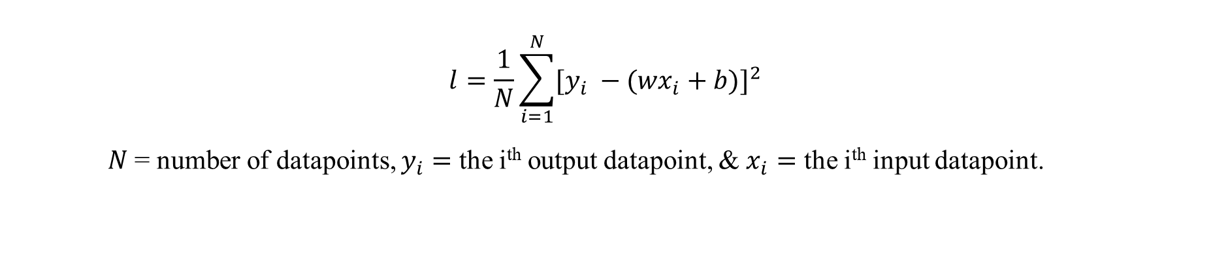
Comparing neural networks with regression
Linear fit (used in linear regression and neural networks):
$$f\left(x\right)=wx+b$$
$w=$ weight of the algorithm, $x=$ input data, & $b=$ bias of the algorithm.
To determine weights and biases, the mean squared error ($l$) of the algorithm is minimised by taking $\dot{l}$ :
$$l=\frac{1}{N}\sum_{i=1}^{N}{{[y_{i} −({wx}_{i}+b)]}^{2}}$$
$N$ = number of datapoints, $y_{i}=$ the i^{th} output datapoint, & $x_{i}=$ the i^{th} input datapoint.

Slide 10
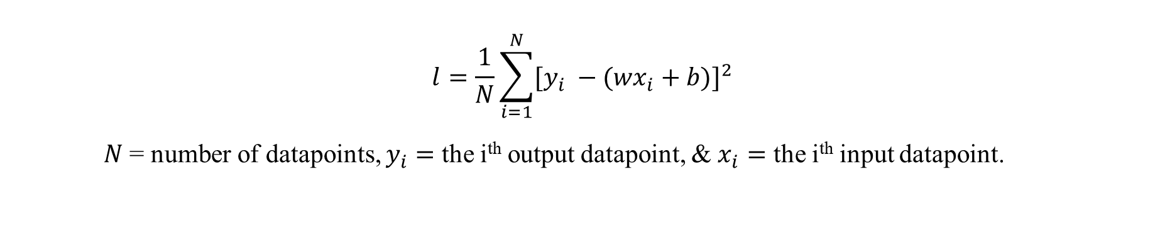

Comparing neural networks with regression
$$l=\frac{1}{N}\sum_{i=1}^{N}{{[y_{i} −({wx}_{i}+b)]}^{2}}$$
$N$ = number of datapoints, $y_{i}=$ the i^{th} output datapoint, & $x_{i}=$ the i^{th} input datapoint.
$$\frac{∂l}{∂w}=−\frac{1}{N}\sum_{i=1}^{N}{{2x}_{i}{[y}_{i} −({wx}_{i}+b)]} \& \frac{∂l}{∂b}=−\frac{1}{N}\sum_{i=1}^{N}{2{[y}_{i} −({wx}_{i}+b)]}$$
Then, the weights and biases are updated using these derivatives and a preset learning rate ($α$):
$$w←w − α\frac{∂l}{dw} \& b←b− α\frac{∂l}{∂b}$$

Slide 11
Creating the desktop application

Slide 12
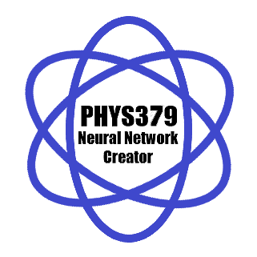

Writing and compiling the program
The program was written and compiled in Python, hence the large file size.
Python libraries used: Tkinter, Matplotlib, Yfinance, Lightkurve, and Pandas.
GitHub directory → ← Application logo

Slide 13
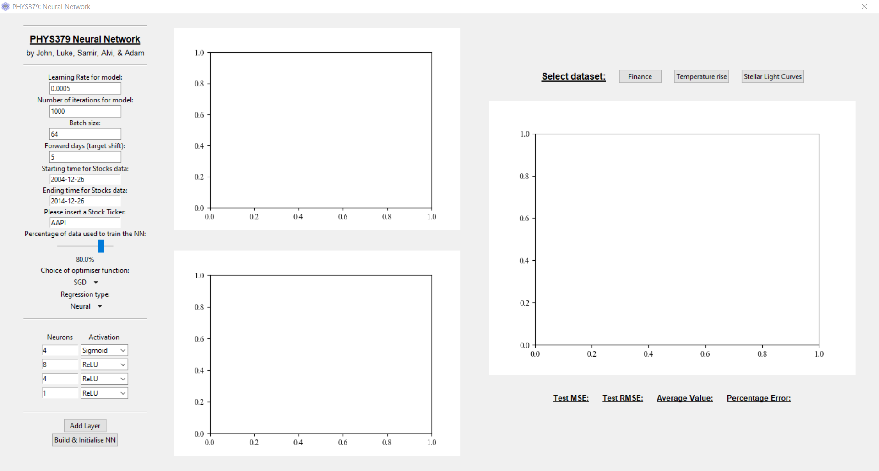
The Graphical User Interface (GUI)

Slide 14
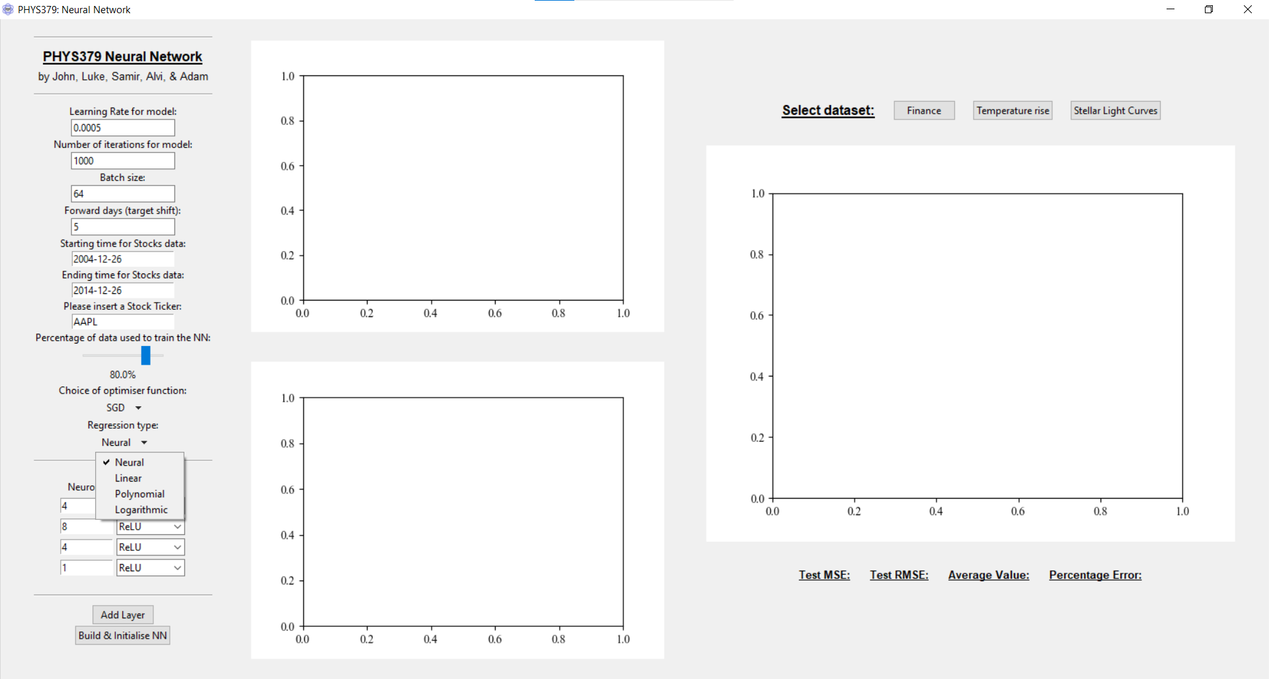

Slide 15
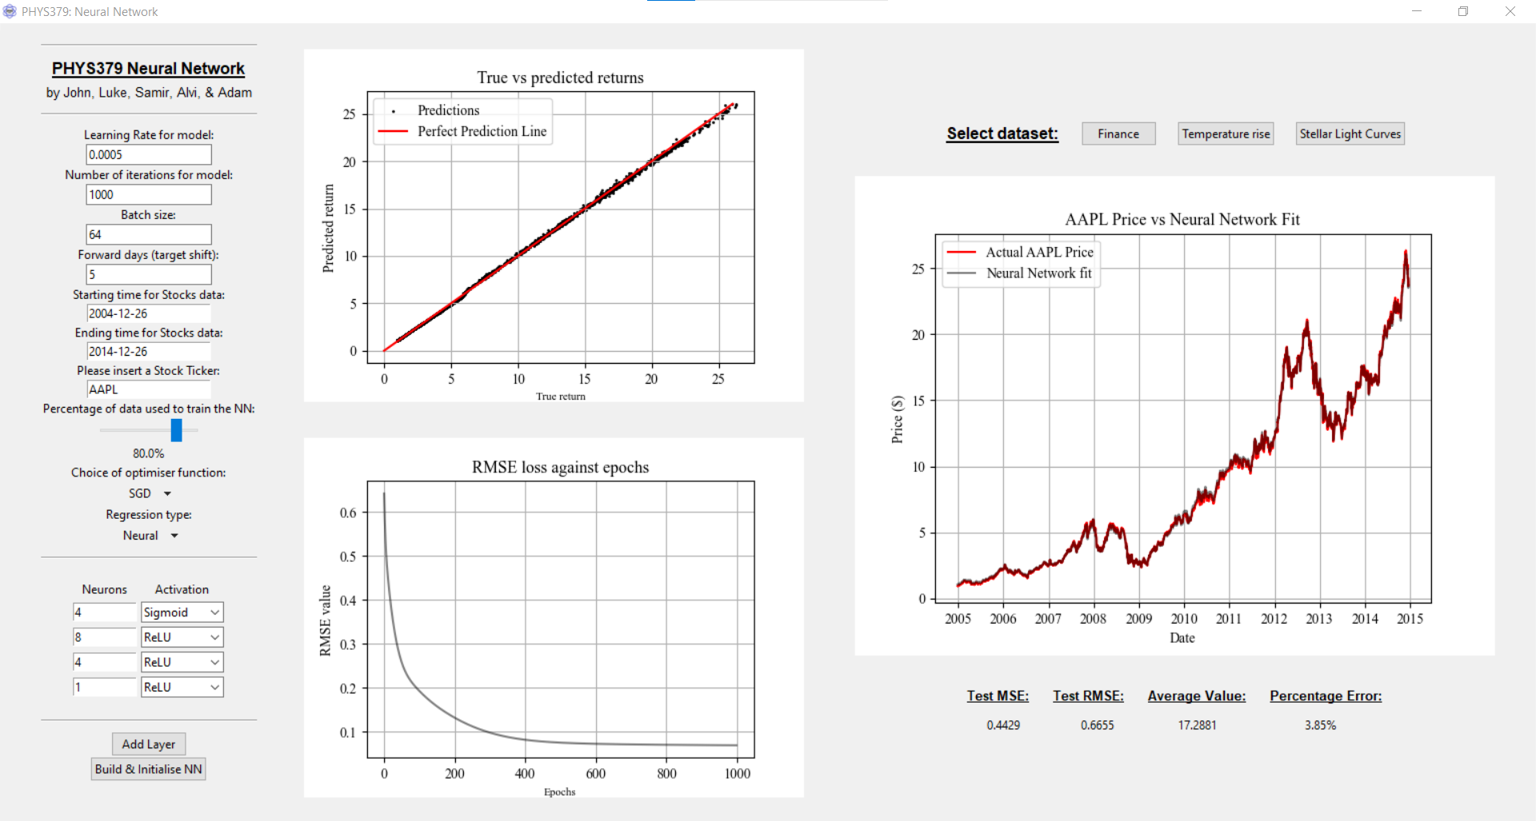

Slide 16
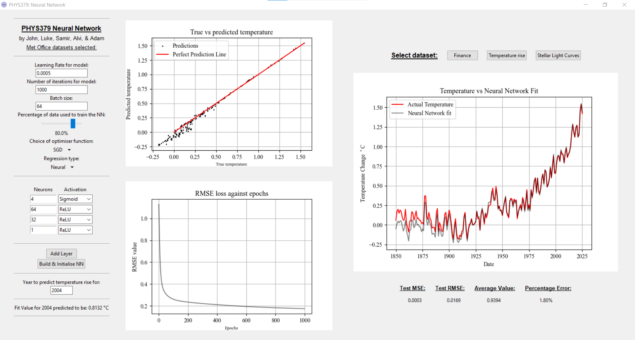

Slide 17
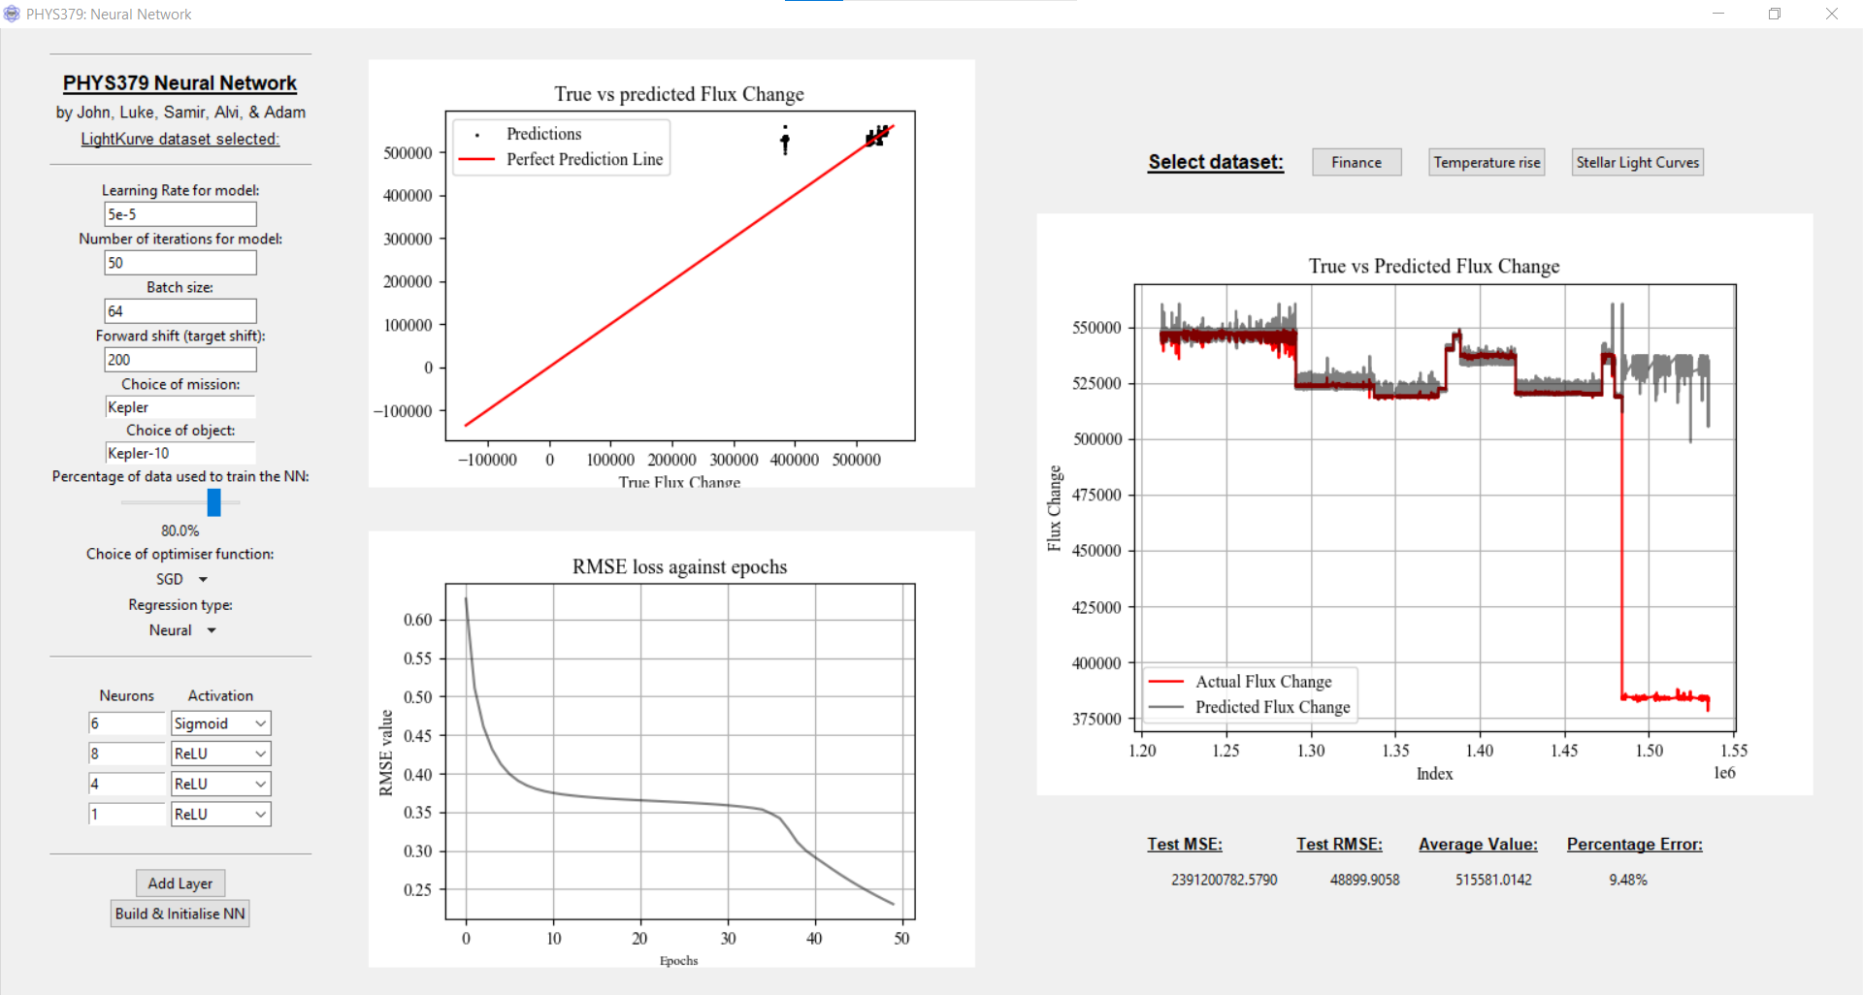

Slide 18
Results and conclusions

Slide 19
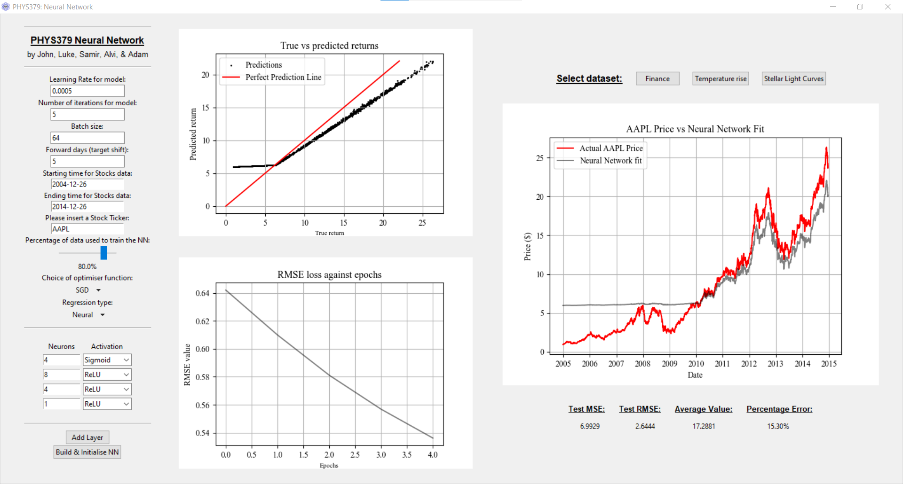
Financial data (from YFinance)

Slide 20
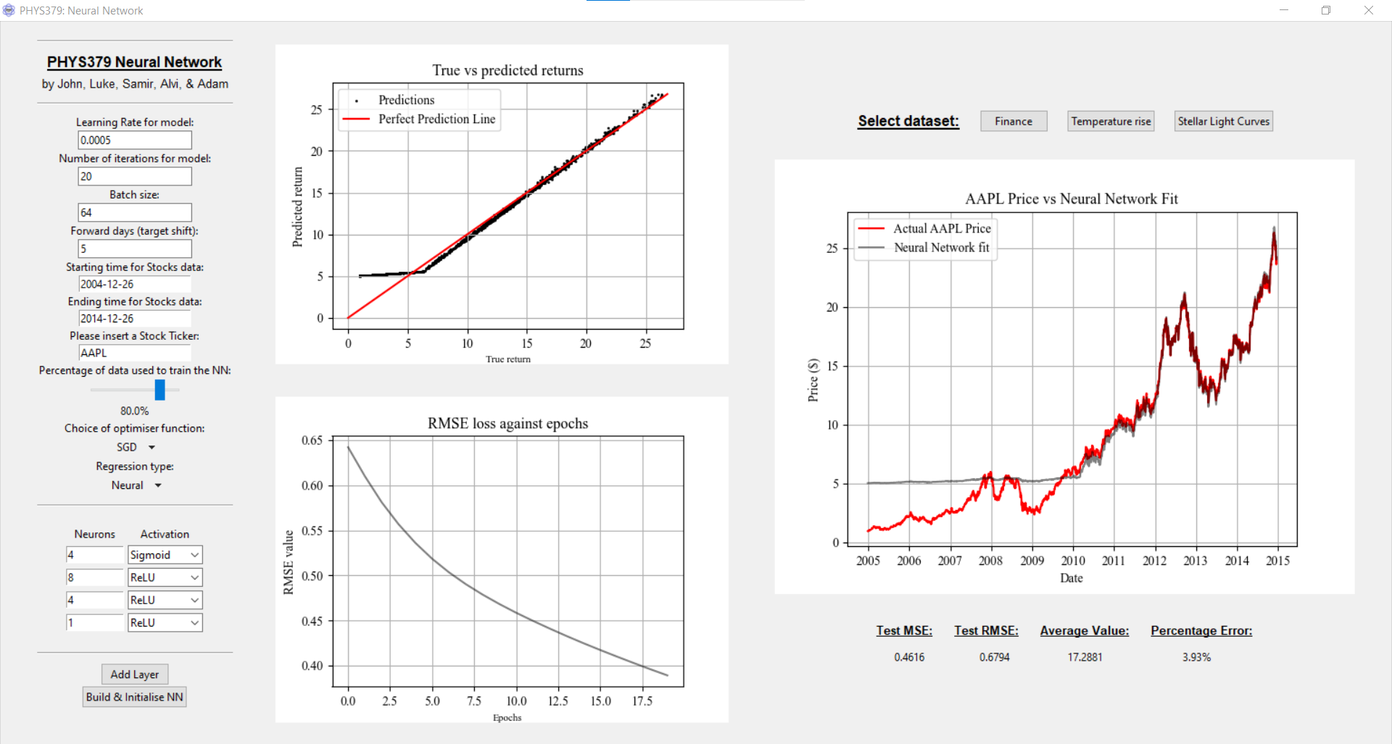
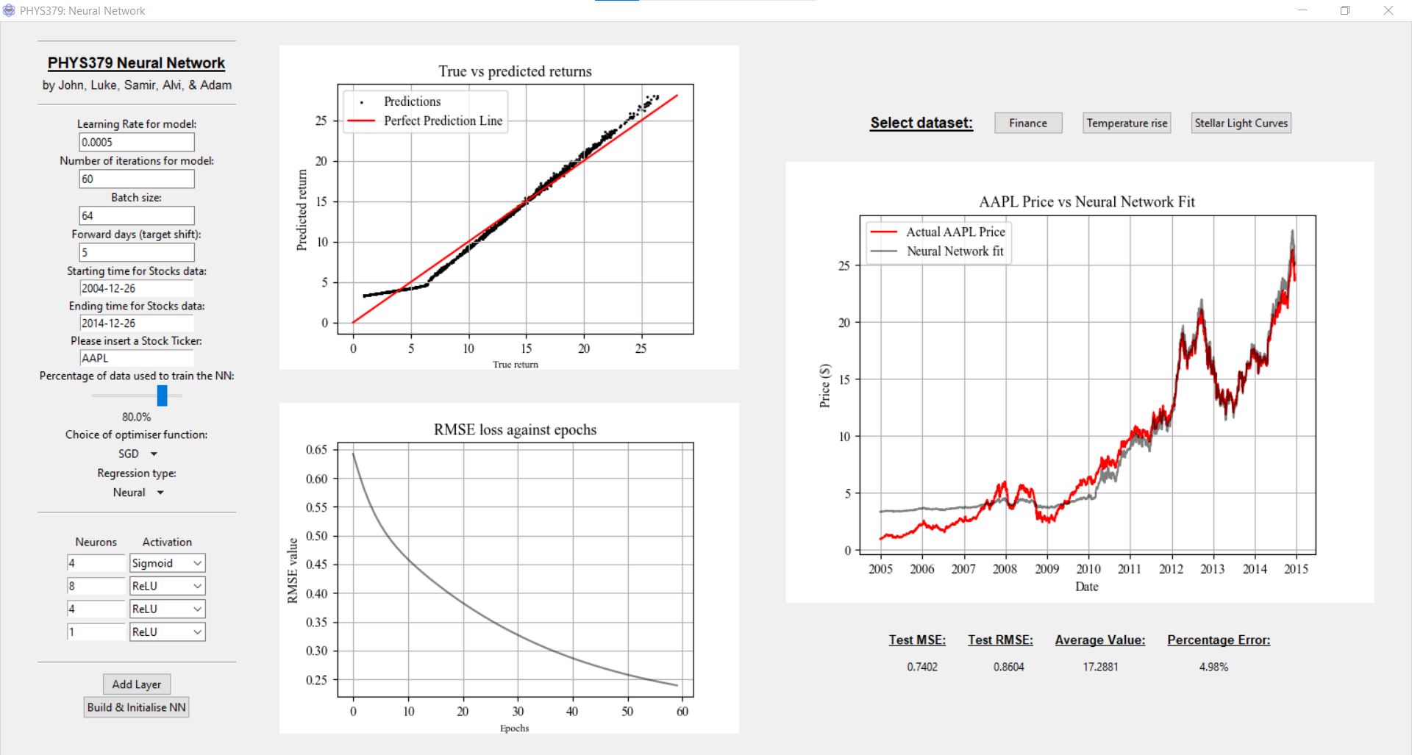
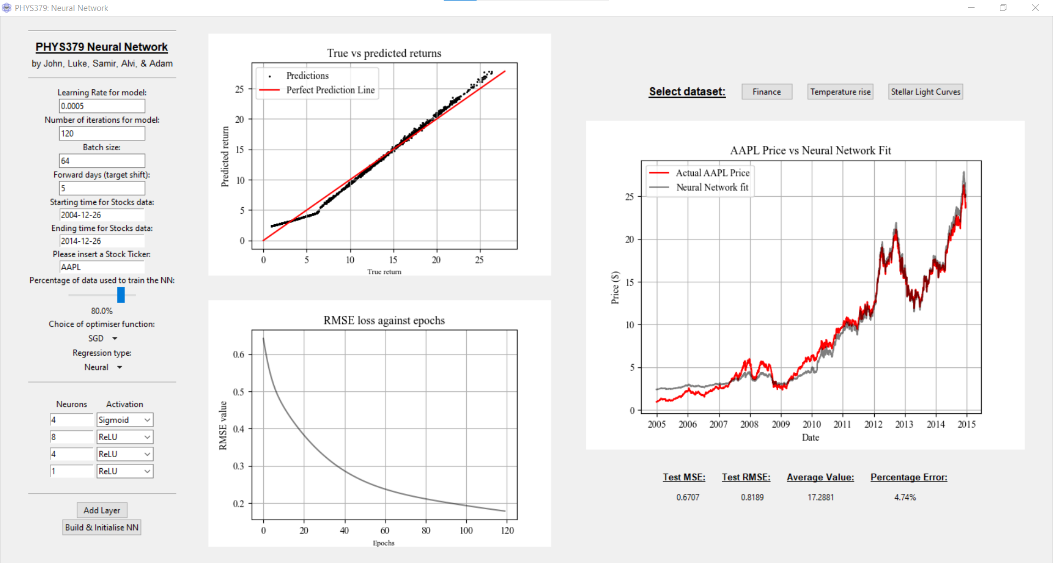
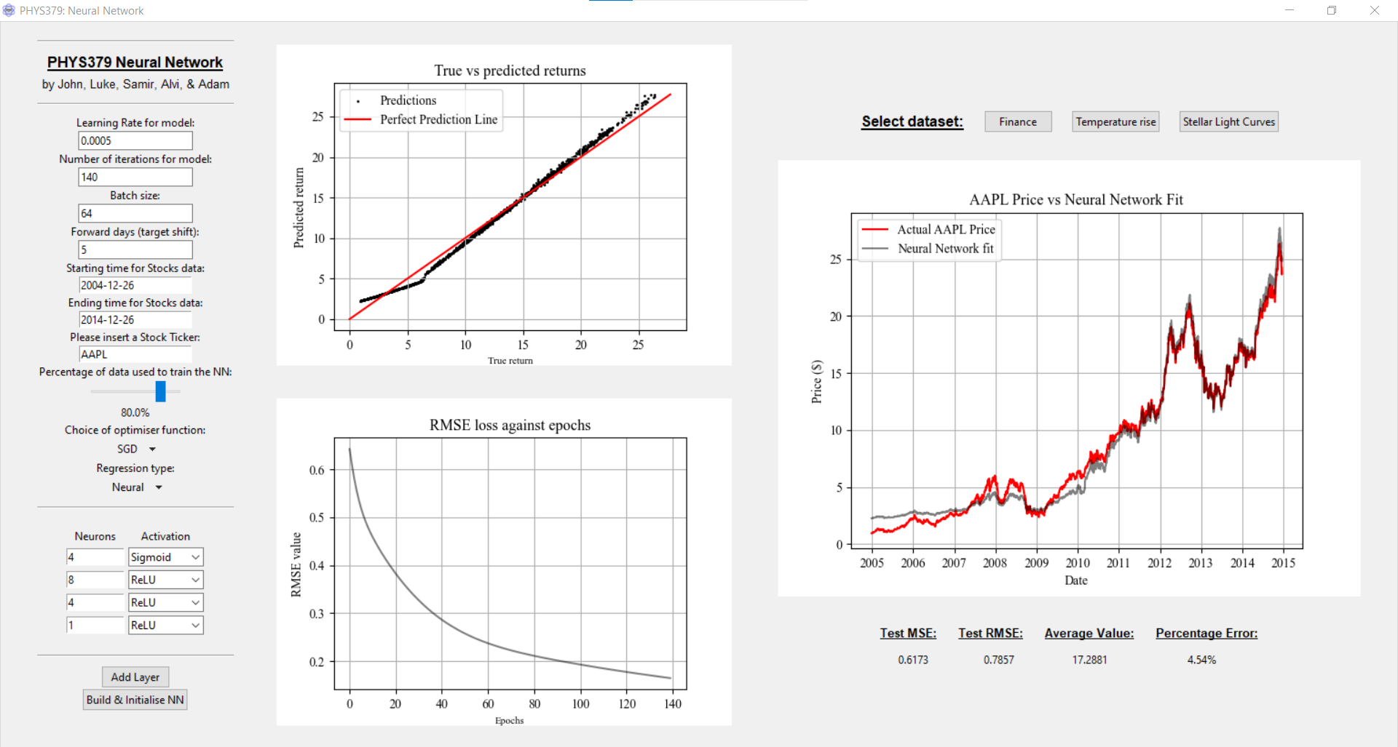
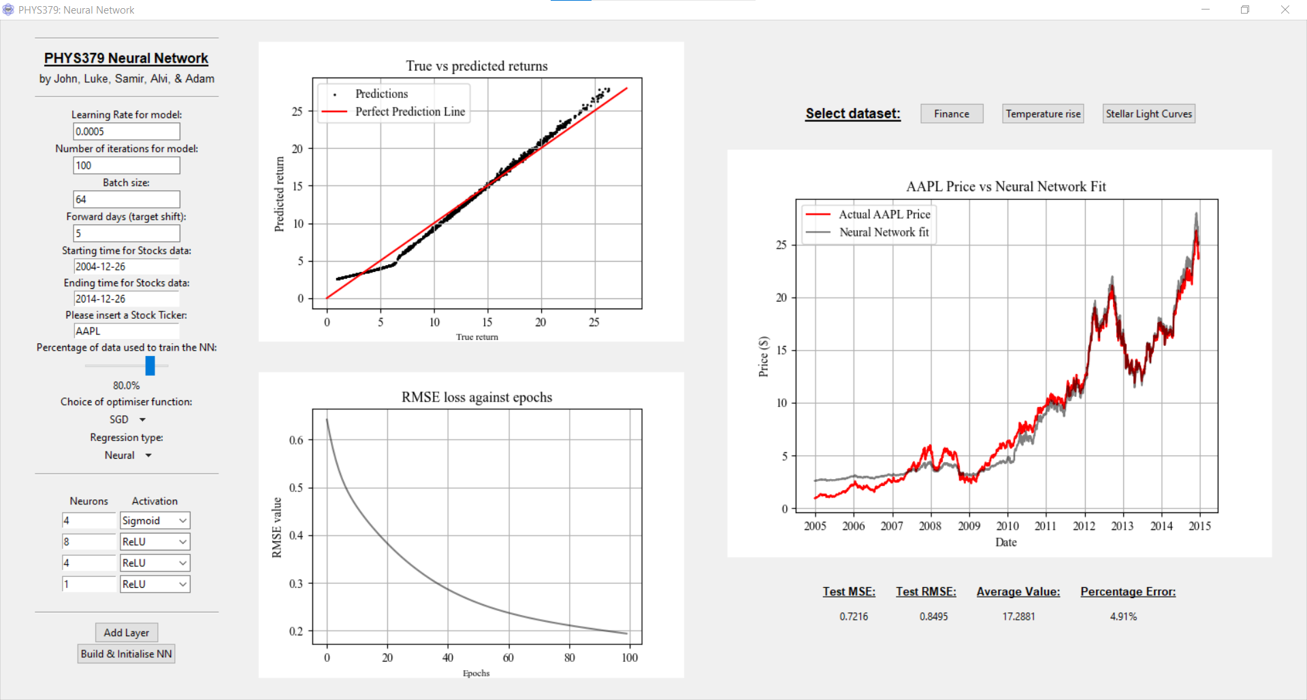
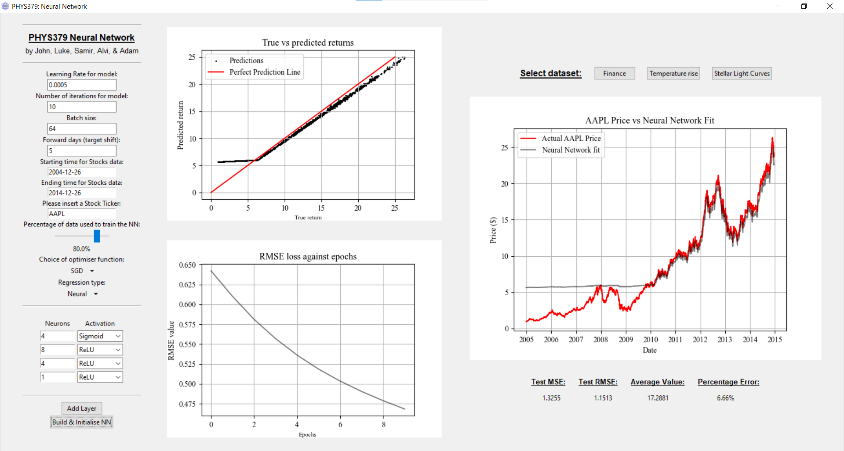
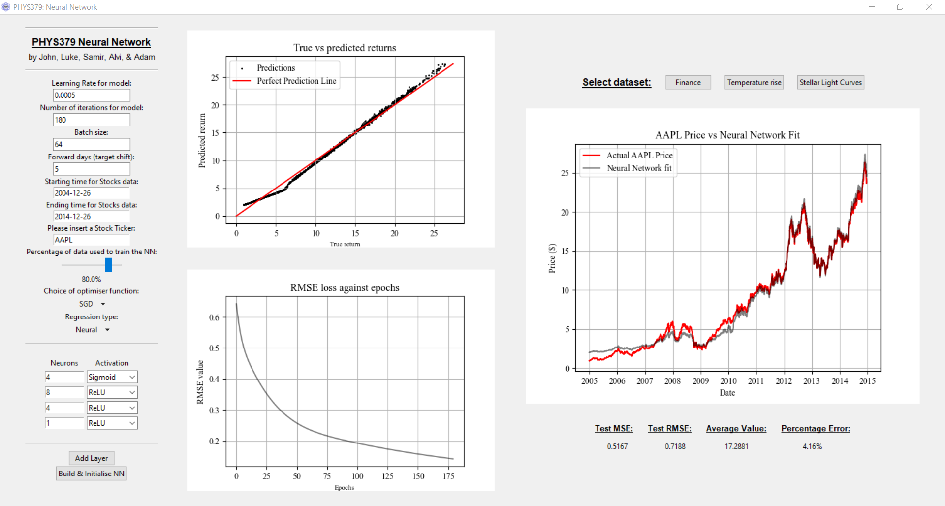
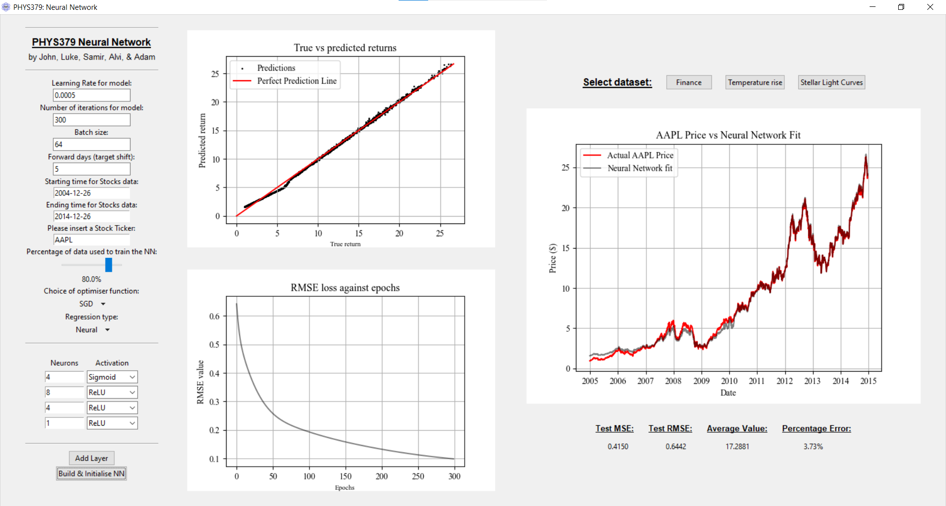
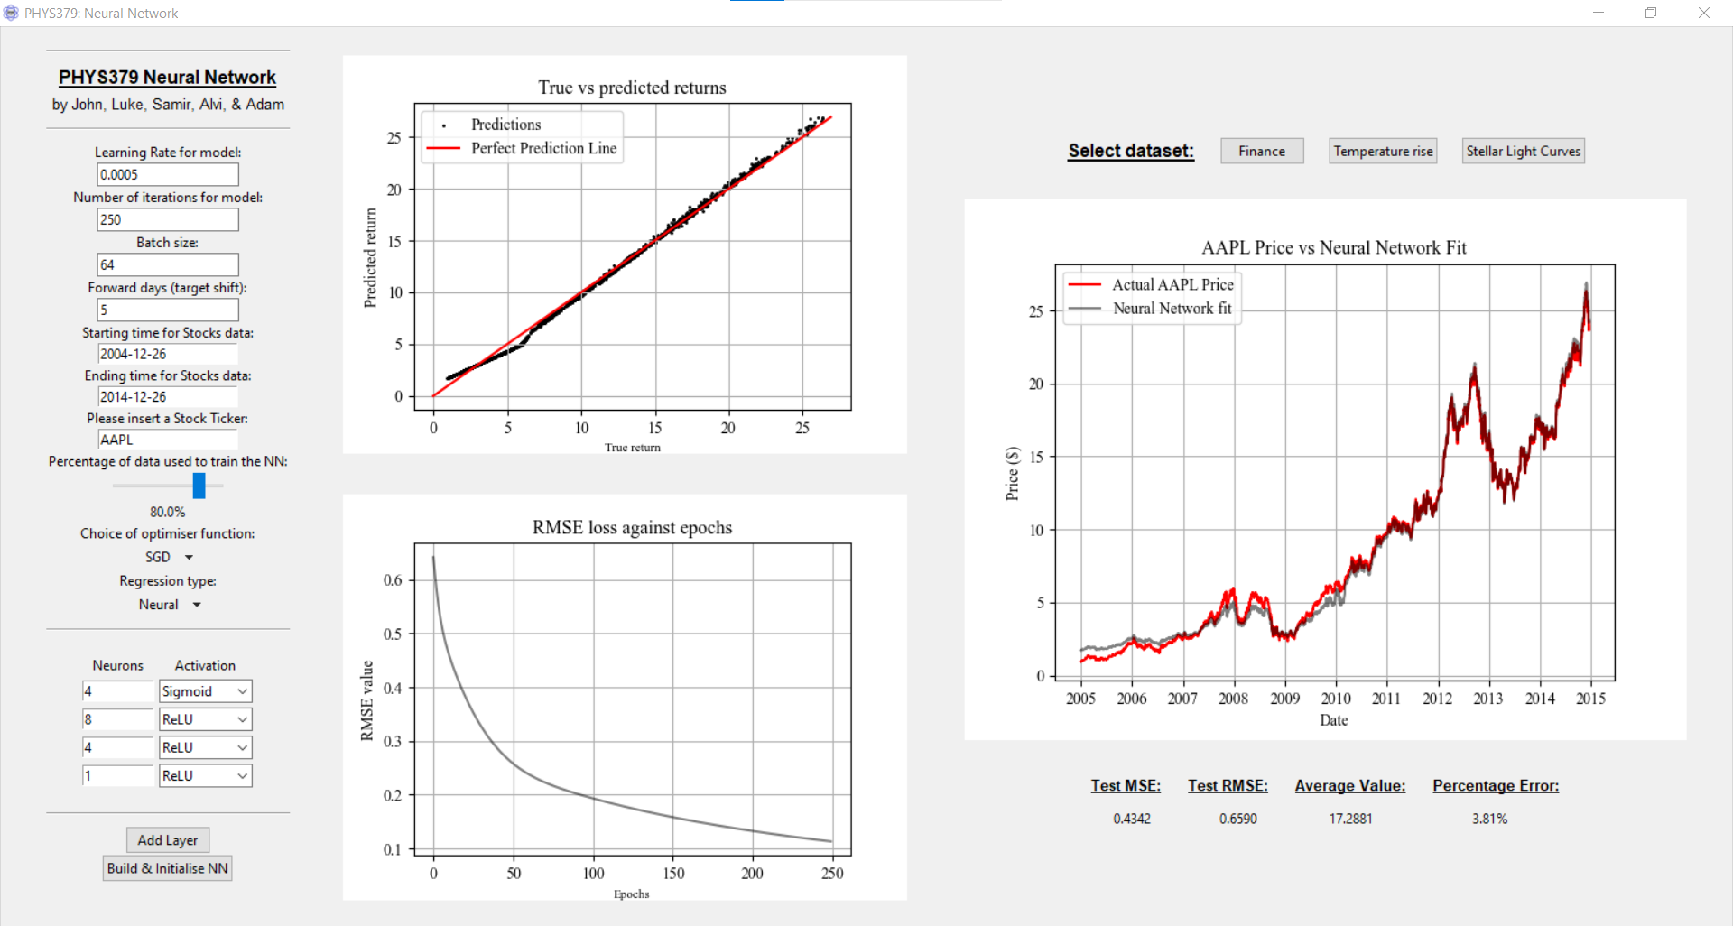

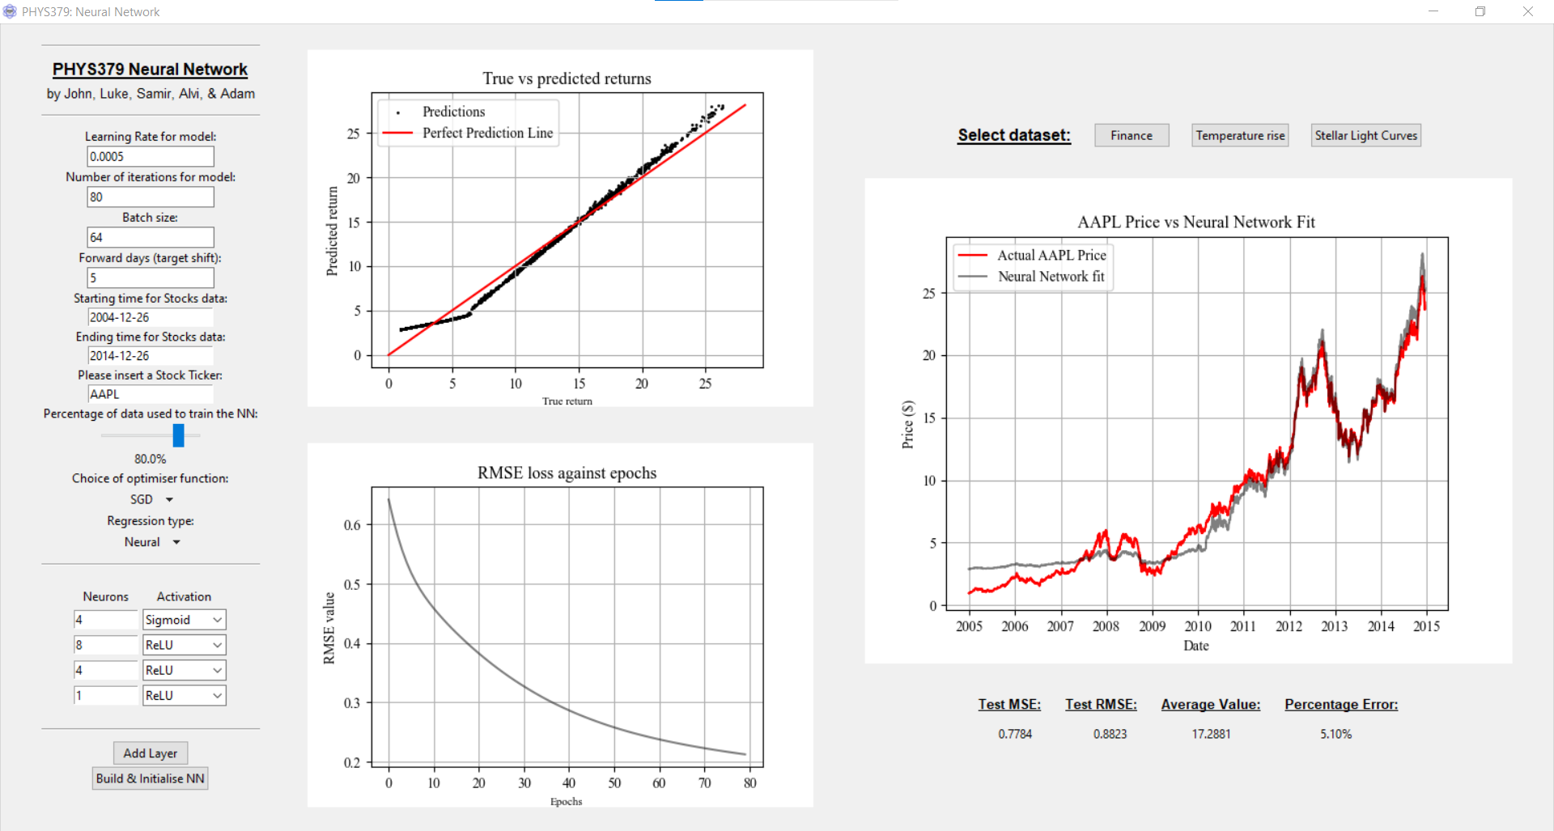
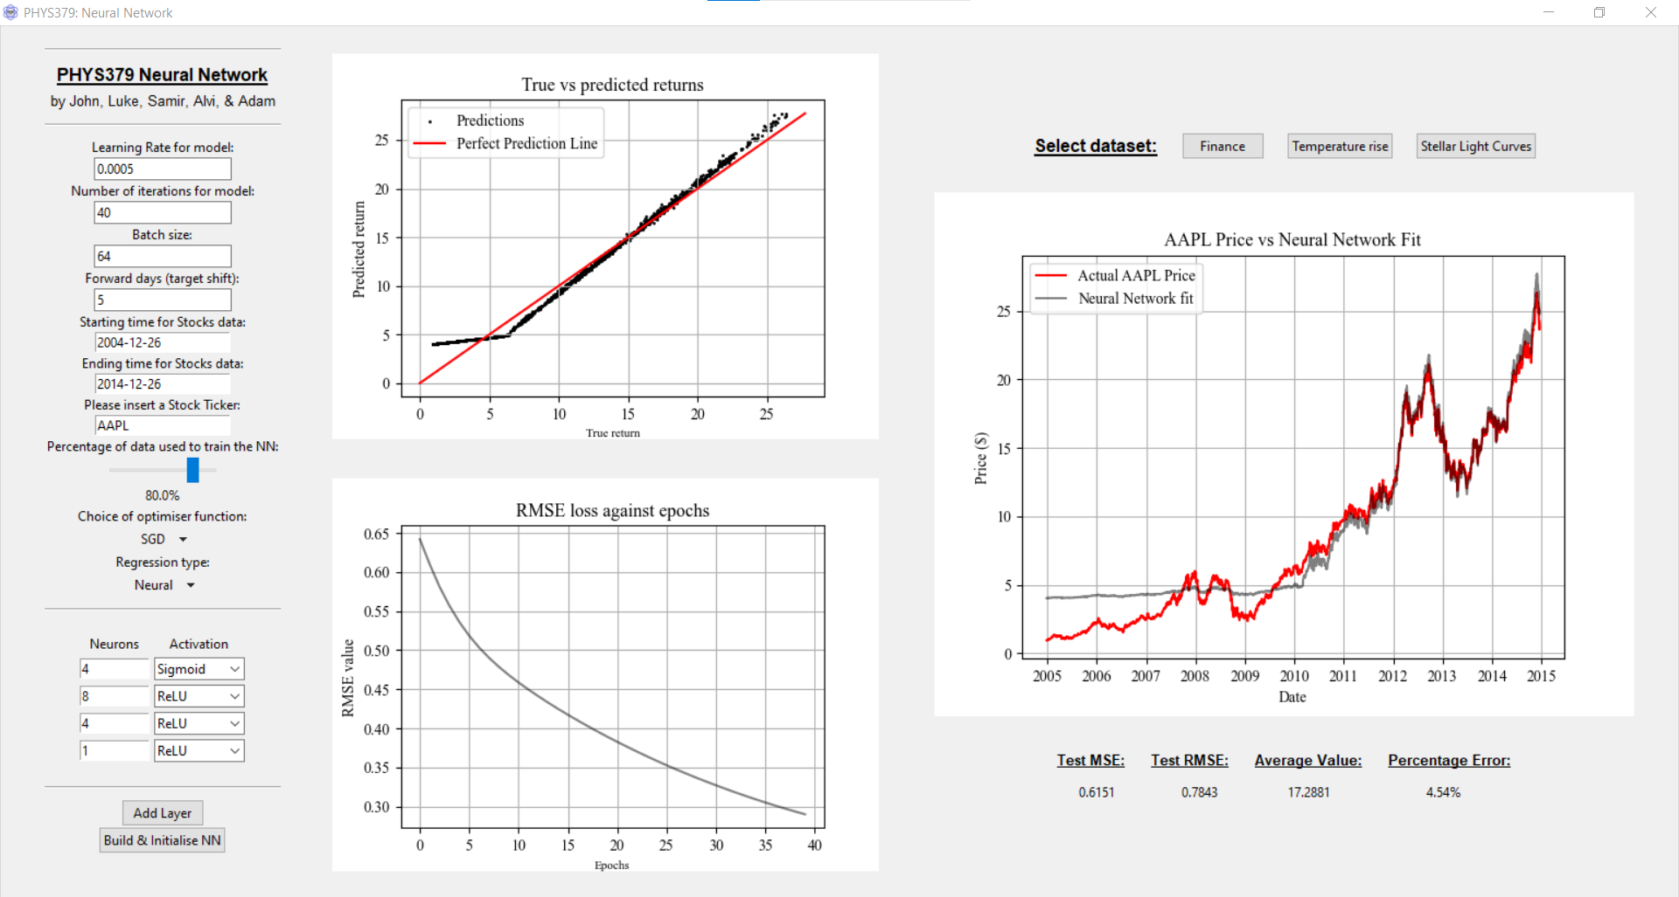

60 iterations – 4.98% error
10 iterations – 6.66% error
40 iterations – 4.54% error
20 iterations – 3.93% error
120 iterations – 4.74% error
100 iterations – 4.91% error
80 iterations – 5.10% error
5 iterations – 15.30% error
140 iterations – 4.54% error
160 iterations – 4.35% error
200 iterations – 4.04% error
180 iterations – 4.16% error
300 iterations – 3.73% error
250 iterations – 3.81% error

Slide 21
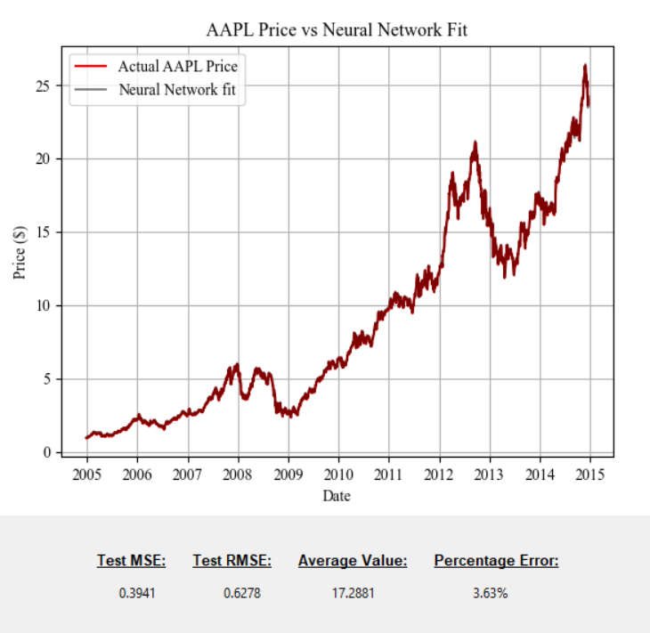
Financial data
Linear regression – 3.63% error

Slide 22
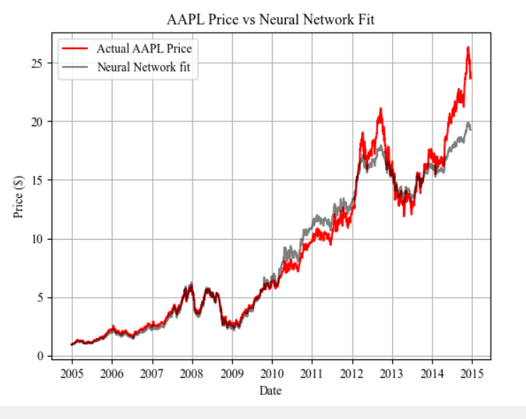
Financial data
Linear regression – 3.63% error
Logarithmic regression – 13.61% error

Slide 23
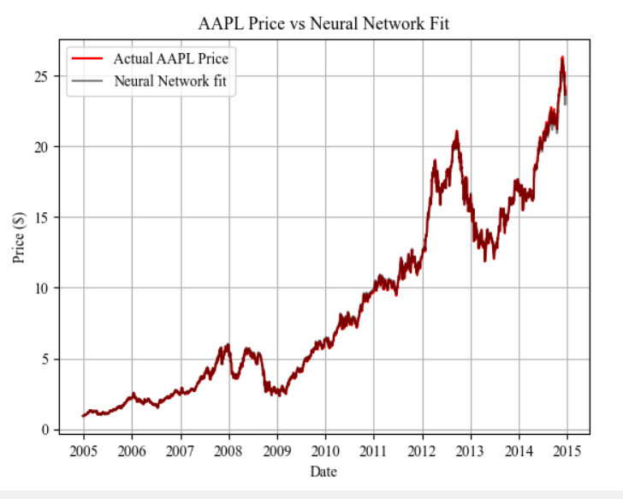
Financial data
Linear regression – 3.63% error
Logarithmic regression – 13.61% error
Polynomial regression – 3.76% error

Slide 24
Financial data
Linear regression – 3.63% error
Polynomial regression – 3.76% error
Logarithmic regression – 13.61% error
The best neural network gives an error of 3.73% – thus linear regression is the best for this dataset.

Slide 25
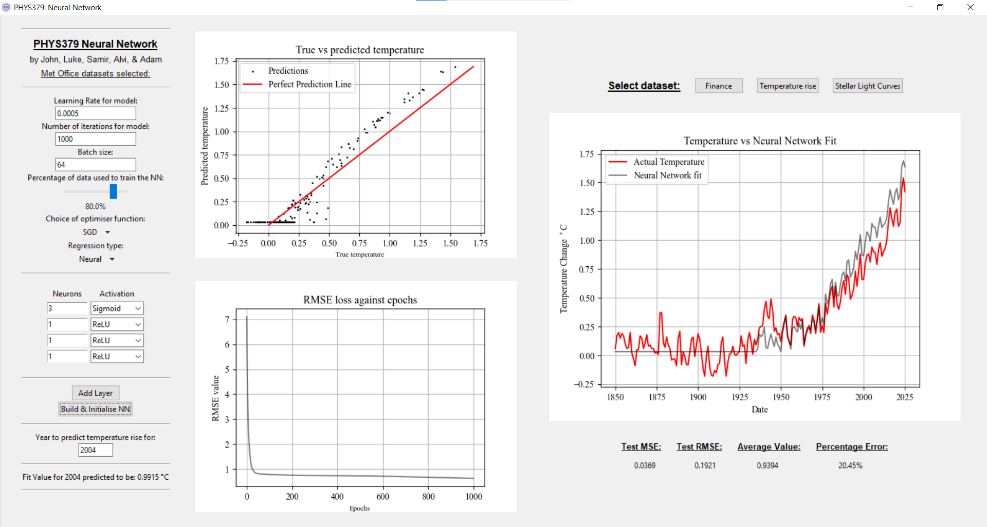
Global Temperature rise data (from the Met Office)

Slide 26
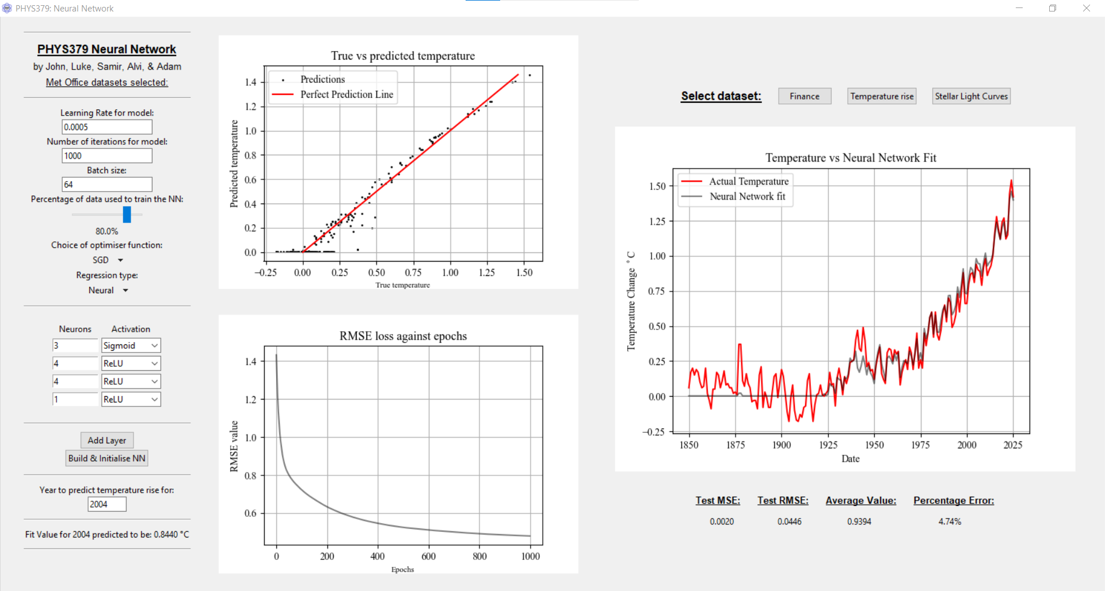
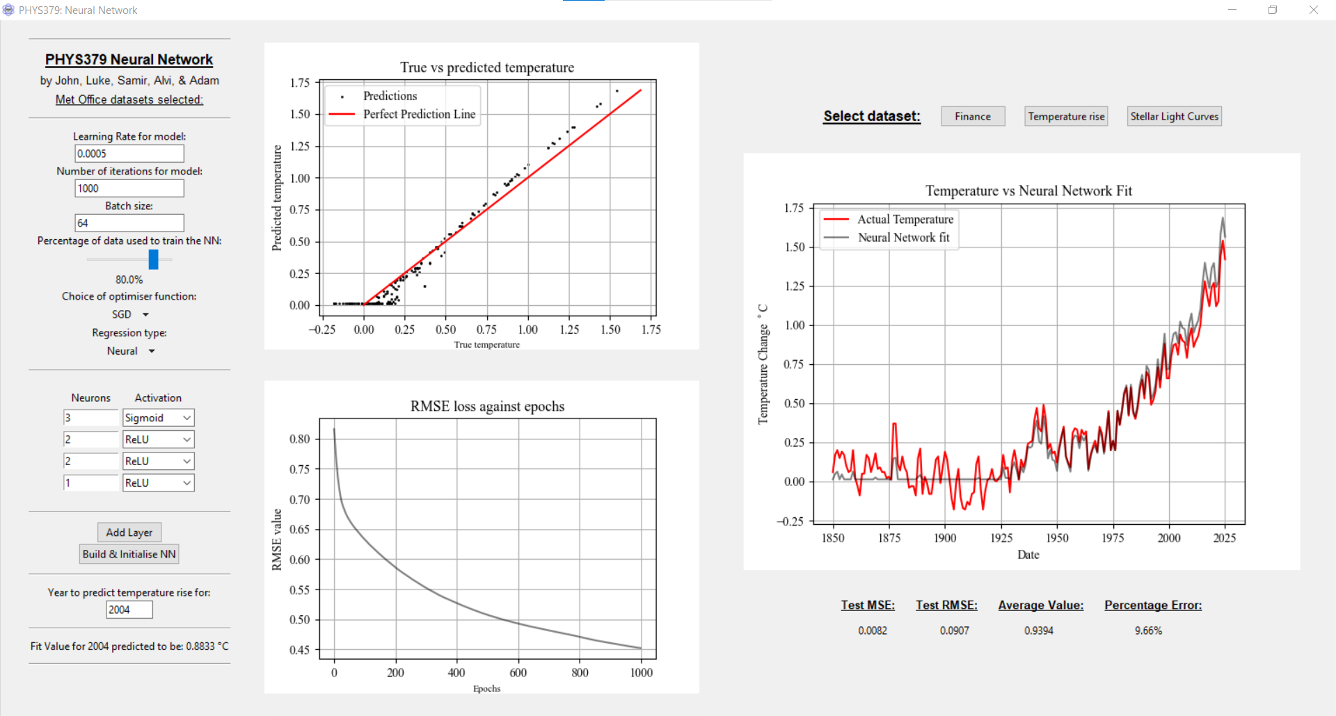
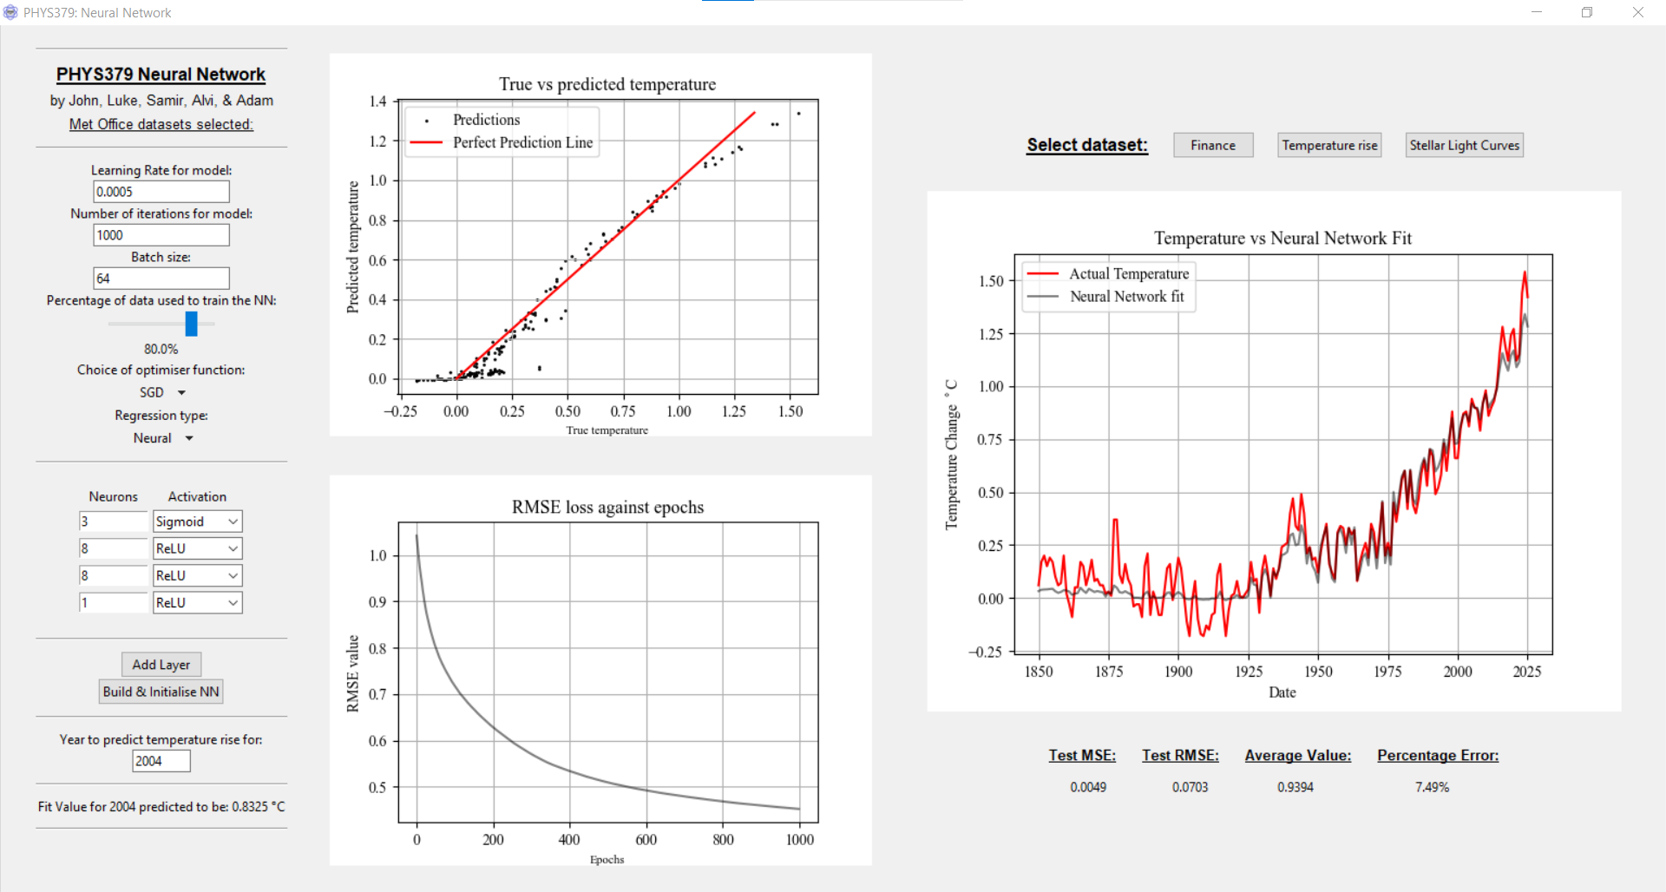
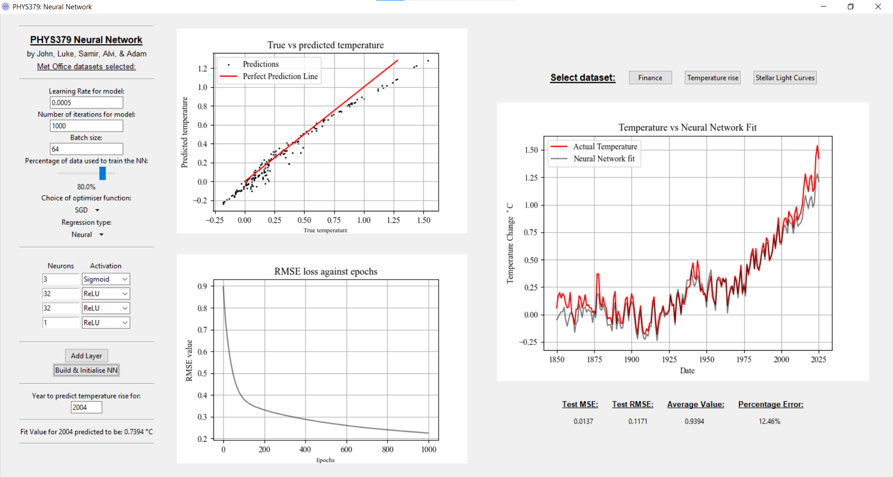
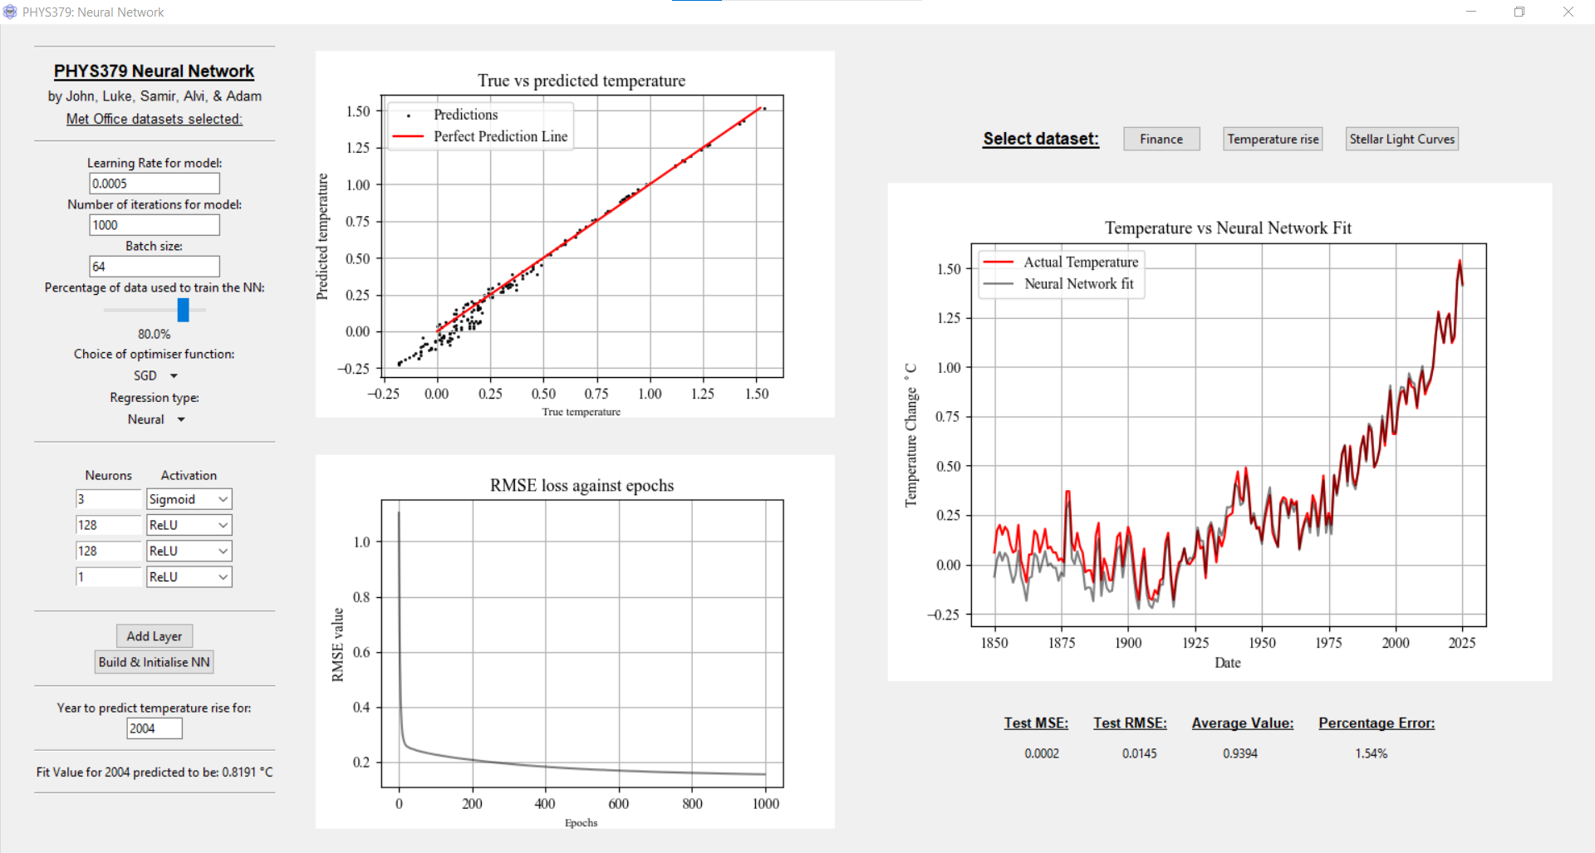
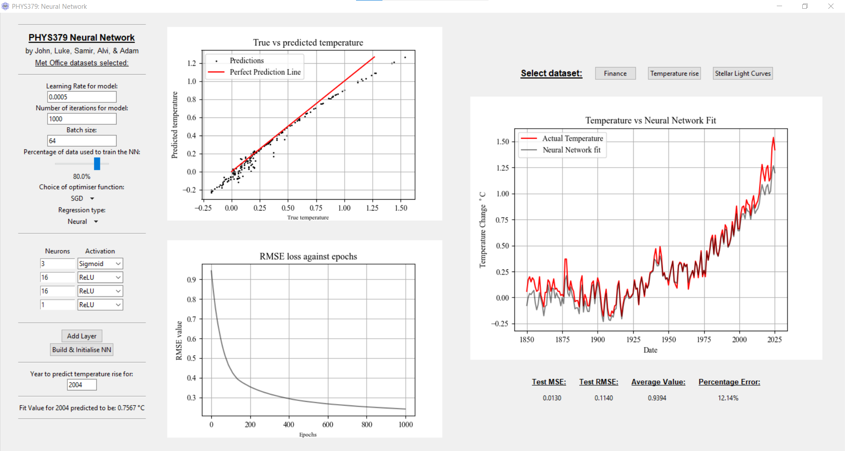
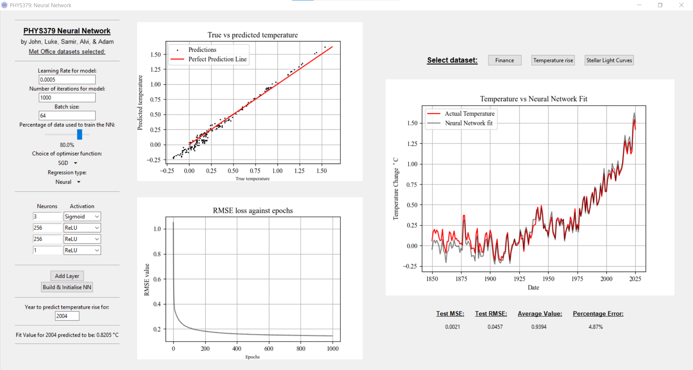
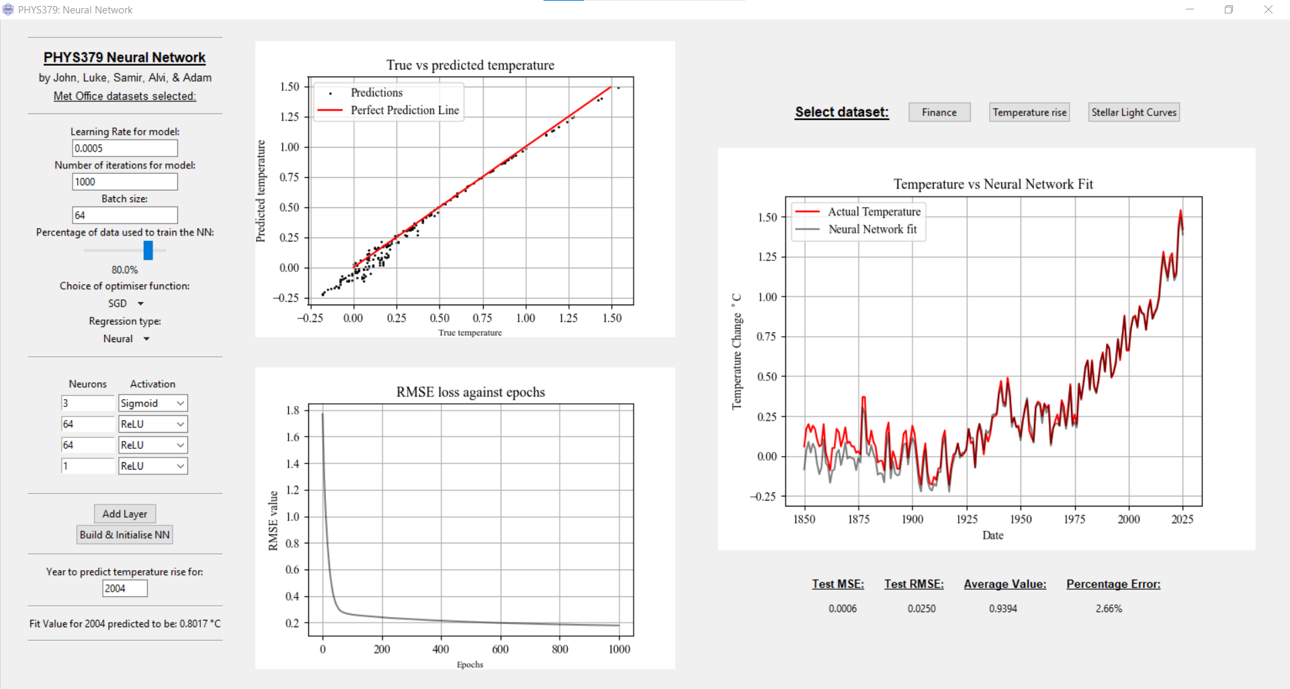
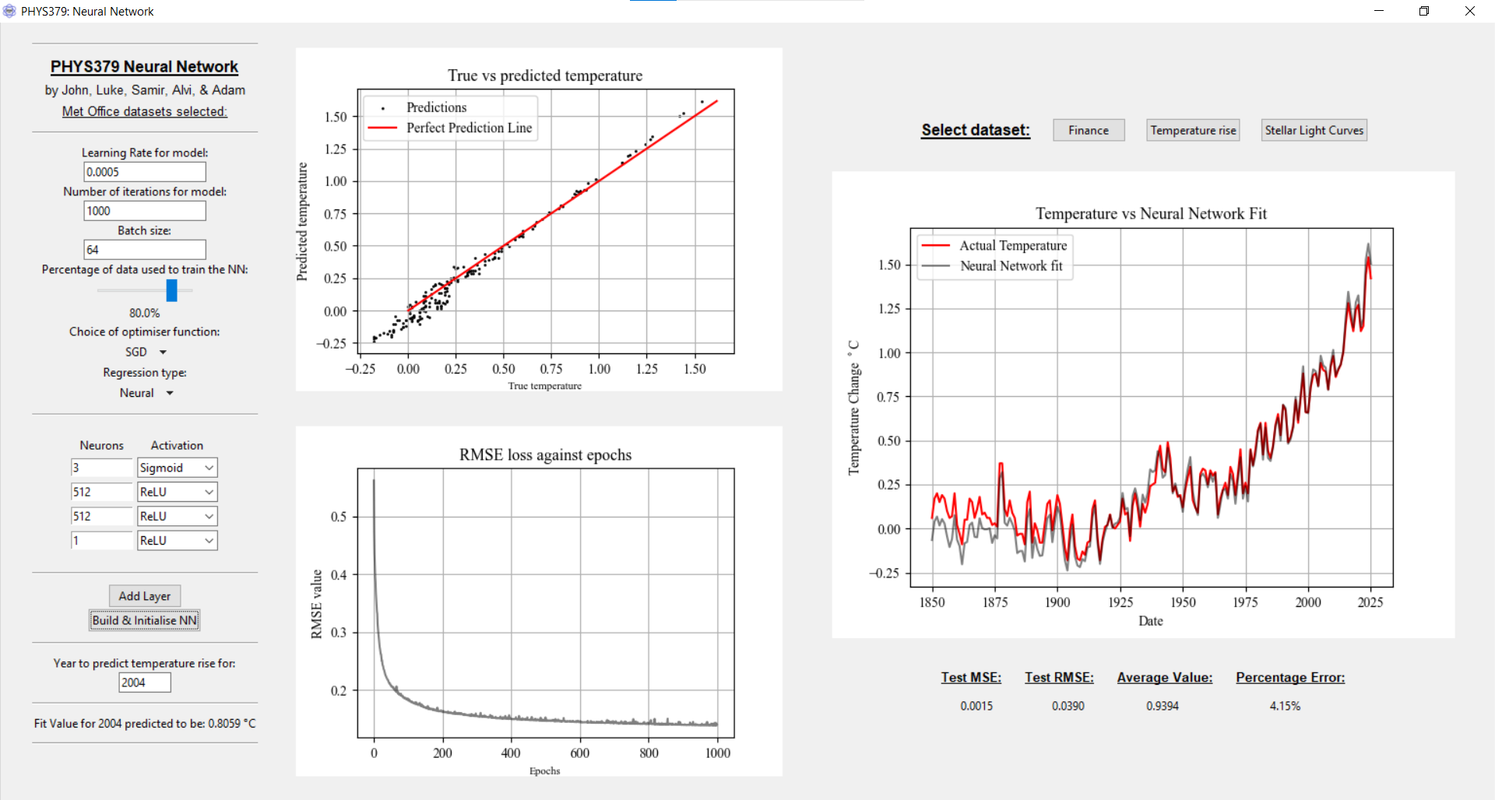
1 neuron per hidden layer – 20.45% error
2 neurons per hidden layer – 9.66% error
4 neurons per hidden layer – 4.74% error
64 neurons per hidden layer – 2.66% error
16 neurons per hidden layer – 12.14% error
8 neurons per hidden layer – 7.49% error
32 neurons per hidden layer – 12.46% error
256 neurons per hidden layer – 4.87% error
128 neurons per hidden layer – 1.54% error
512 neurons per hidden layer – 4.15% error

Slide 27
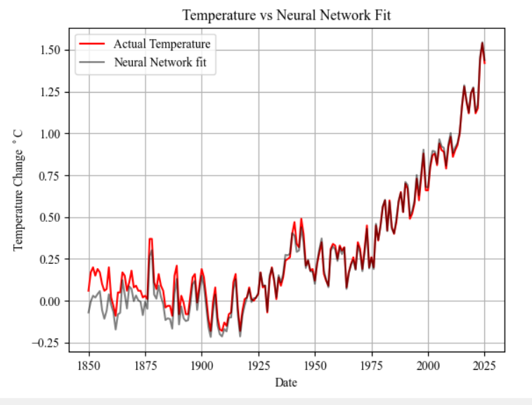
Temperature rise data
Linear regression – 2.03% error

Slide 28
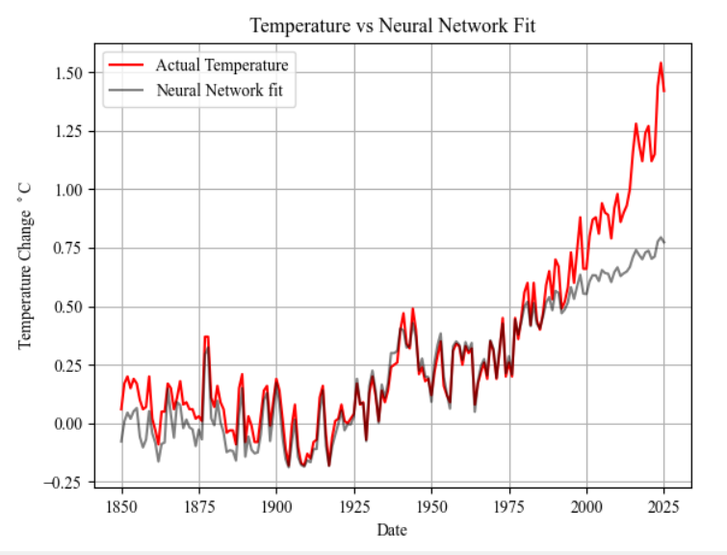
Temperature rise data
Linear regression – 2.03% error
Logarithmic regression – 37.03% error

Slide 29
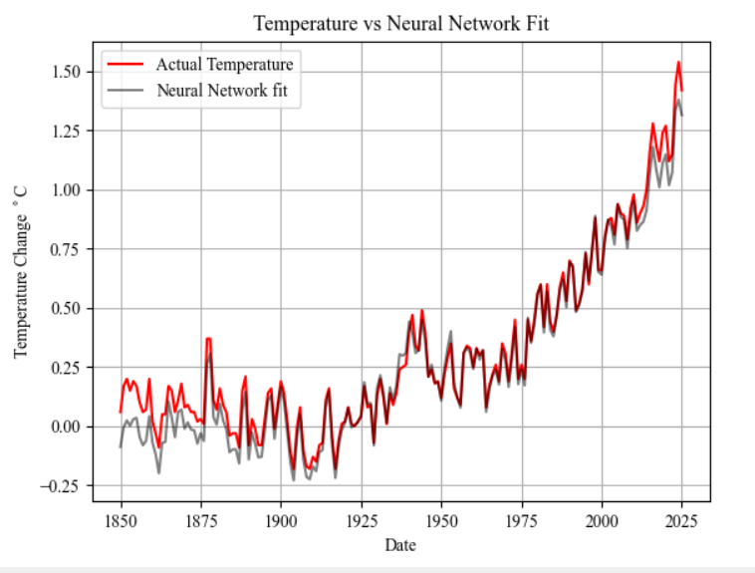
Temperature rise data
Linear regression – 2.03% error
Logarithmic regression – 37.03% error
Polynomial regression – 7.11% error

Slide 30
Temperature rise data
Linear regression – 2.03% error
Polynomial regression – 7.11% error
Logarithmic regression – 37.03% error
The best neural network gives an error of 1.54% - thus neural networks are best for this dataset.

Slide 31
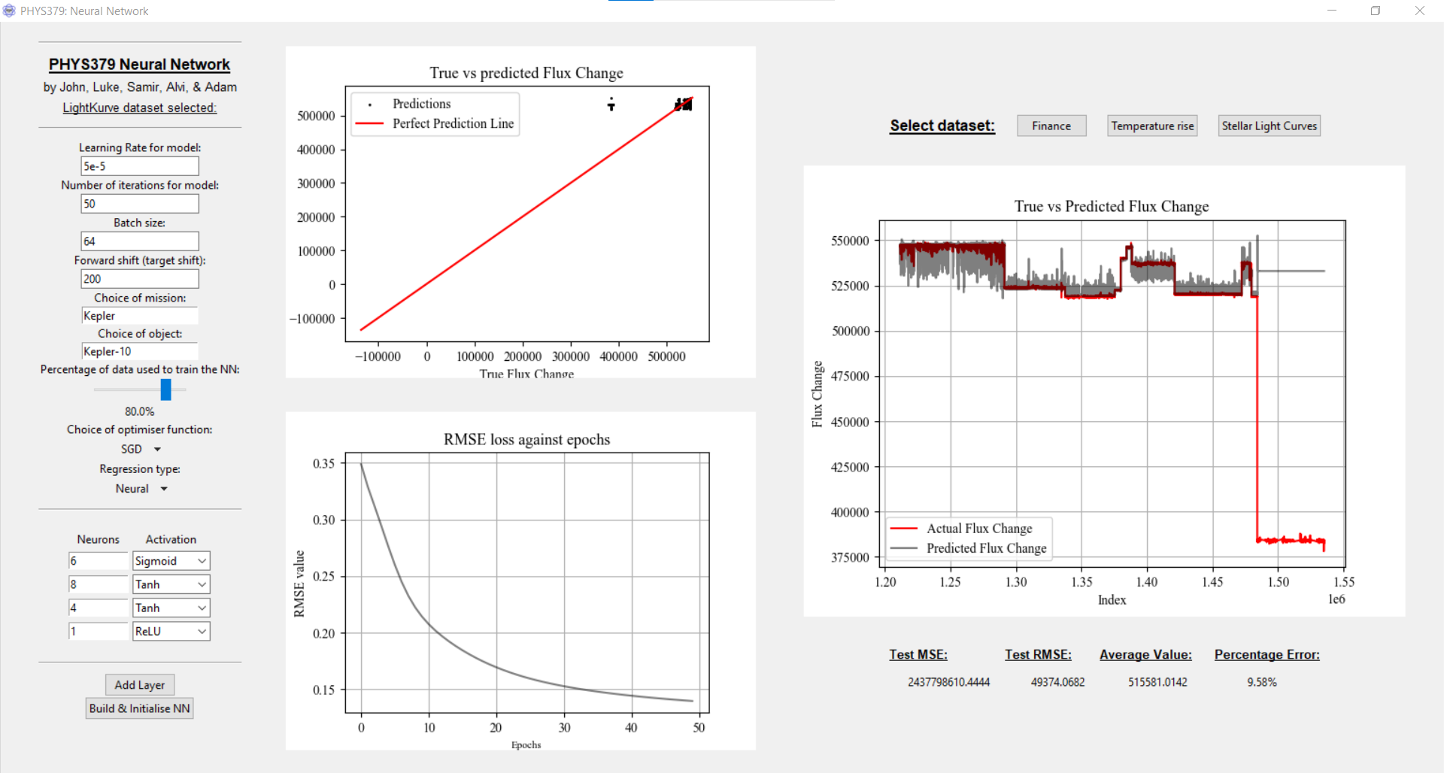
Stellar light curve data (from NASA)

Slide 32
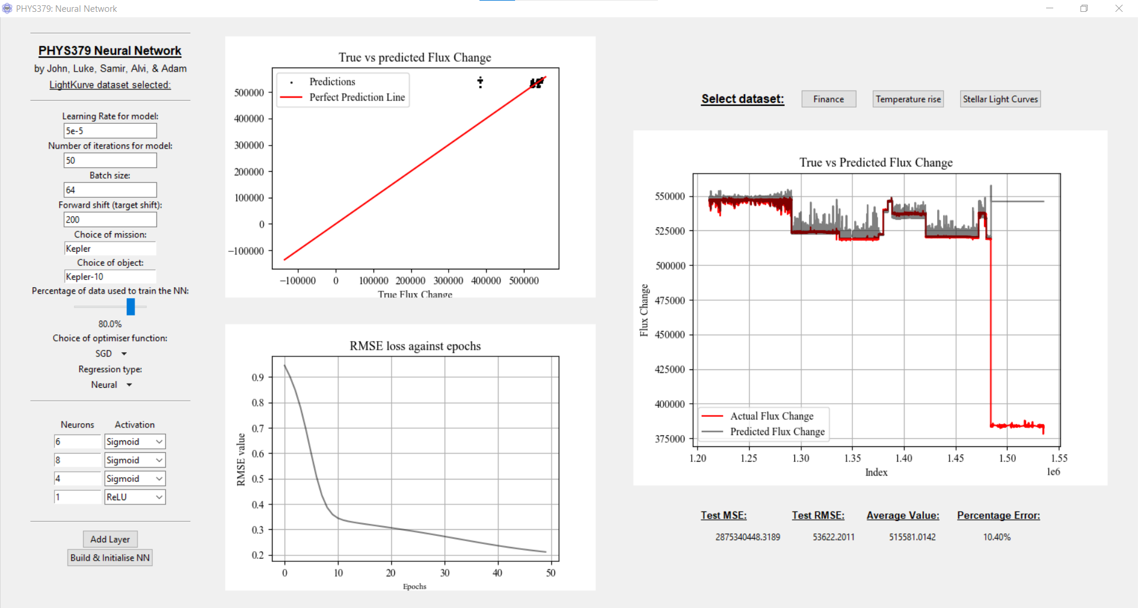
Sigmoid activation functions – 10.40% error
ReLU activation functions – 9.48% error
Tanh activation functions – 9.58% error

Slide 33
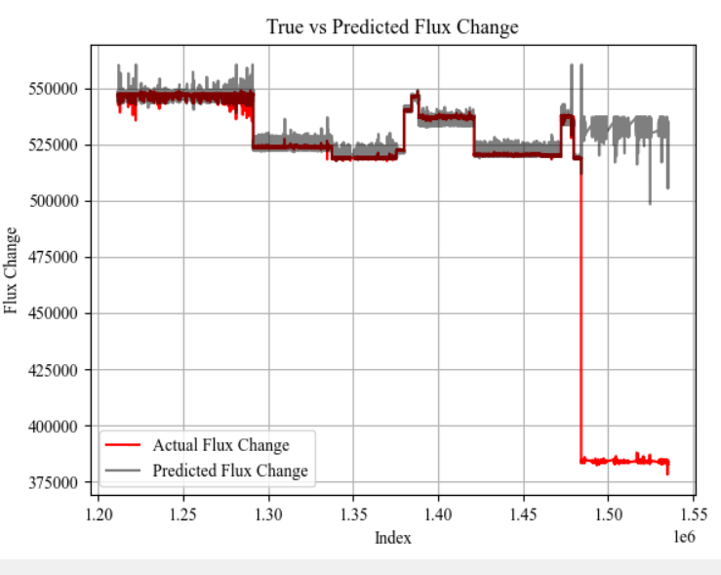
Stellar light curve data
ReLU Neural Network – 9.48% error

Slide 34
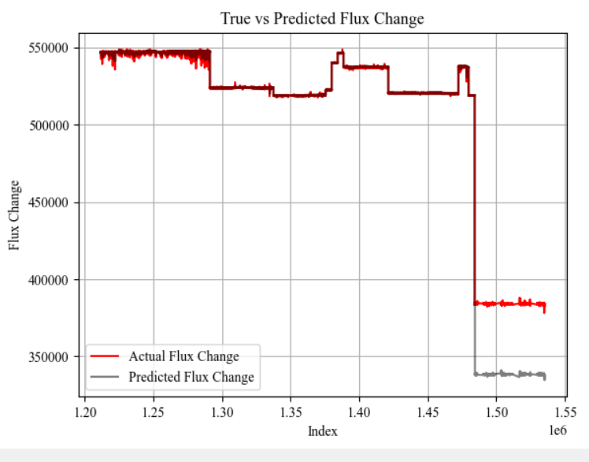
Stellar light curve data
ReLU Neural Network – 9.48% error
Linear regression – 3.00% error

Slide 35
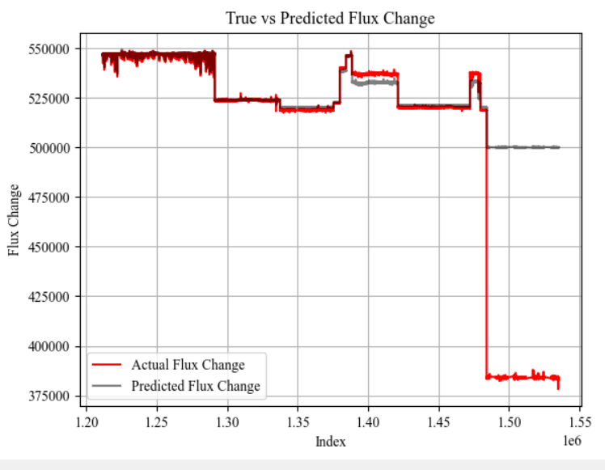
Stellar light curve data
Linear regression – 3.00% error
ReLU Neural Network – 9.48% error
Logarithmic regression – 7.48% error

Slide 36
Stellar light curve data
Linear regression – 3.00% error
Logarithmic regression – 7.48% error
ReLU Neural Network – 9.48% error
Linear regression gives the smallest error for this dataset, compared to neural networks with small iterations.

Slide 37
Future development

Slide 38
Future development
Allow custom datasets to be uploaded to use in the program.
Allow models to be saved – for future use.
Add directional accuracy, lookback windows, and other advanced methods.
Allow the program to classify images.
Improve the efficiency of the NASA light curve dataset with the program.
Notes:
These edge states correspond to the single-cell connections of the outermost sites in the system (and thus only emerge if ordinary boundary conditions are followed).

Slide 39
Thank you for listening. Any questions?

